Slide 1
Linear and Logistic Regression
Amos Azaria

Slide 2





Estimating Galaxy-Phone Cost by Name

Slide 3
Formalizing Linear Regression
y = wx + b
What would we do if we had only 2 training examples?
Our prediction will be h(x) = wx + b
Y={y₁,y₂,y₃…y_{m}}, X={x₁,x₂,x₃,…x_{m}}
Loss function:
Or:
Find w, b that will minimize J(w,b)
We could solve 2 equations with 2 parameters

Slide 4

Closed form solution
Linear regression has a closed-form solution:
We won't be focusing on it since we will be moving beyond linear regression to problems that do not have closed-form solution.
Furthermore, the closed form solution may be less practical for big data.
We will be using gradient descent (and its variants) until the end of the course.
Notes:
I'm only providing it for soundness
http://www.dsplog.com/2011/12/04/closed-form-solution-linear-regression/
(big data: especially when the X is sparse, but X^T X is dense.)

Slide 5
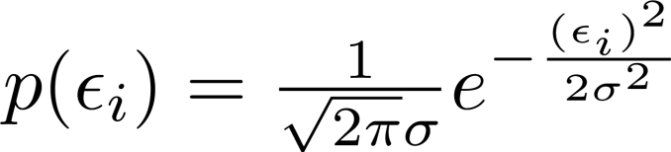
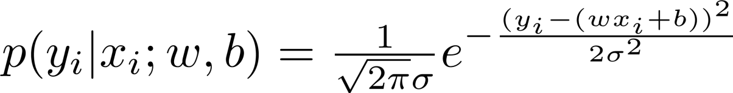
Motivation to loss function
Assume I.I.D. (independently and identically distributed) Gaussian noise with 0 mean and σ² variance:

Slide 6
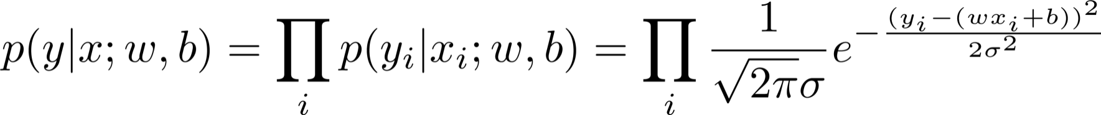
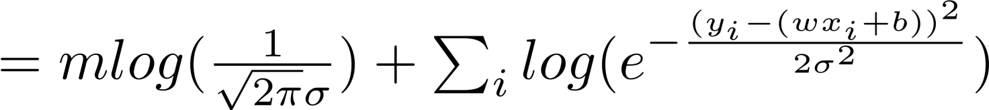
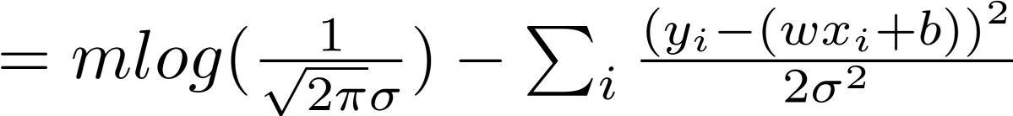
Maximum Likelihood Estimation (MLE)
We want to find the parameters (w,b) that maximize the likelihood (probability) of the labels (y) given the data (x):
Instead of maximizing p(y|x), we can maximize log(p(y|x))
How do we maximize the above sum?
Why do we divide by m?
We want to normalize the loss. So that a larger data-set doesn't immediately impose a larger error.
Notes:
X is given, so there is no need to include it while maximizing the likelihood. The parameters only control y.
We don't want to assume that all the results we got are arbitrary and just because of the noise.
Intuitively, we want to find the most likely parameters (w,b).

Slide 7
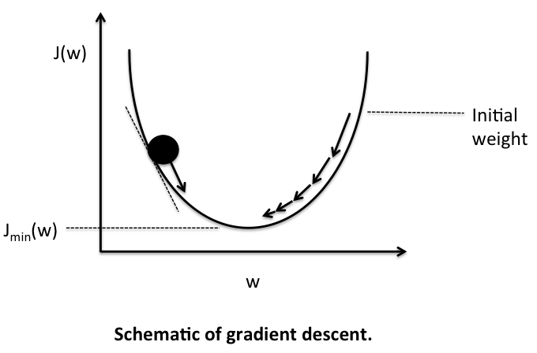
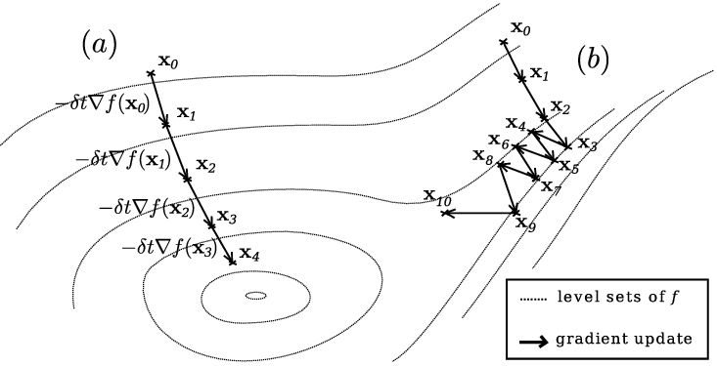
Gradient Descent
Note:
the function we are trying to minimize (J(w,b)) has multiple parameters.
It is dificult to find values that zero the derivative.

Slide 8
What is the gradient (∇)?
A vector representing the derivation of a function that has multiple parameters.
Each entry is the function's derivative with respect to one of the parameters.

Slide 9
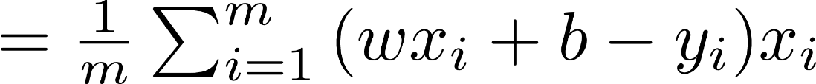
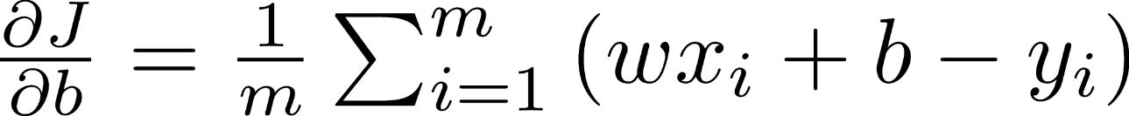
The Gradient for Linear Regression
Our loss function:

Slide 10
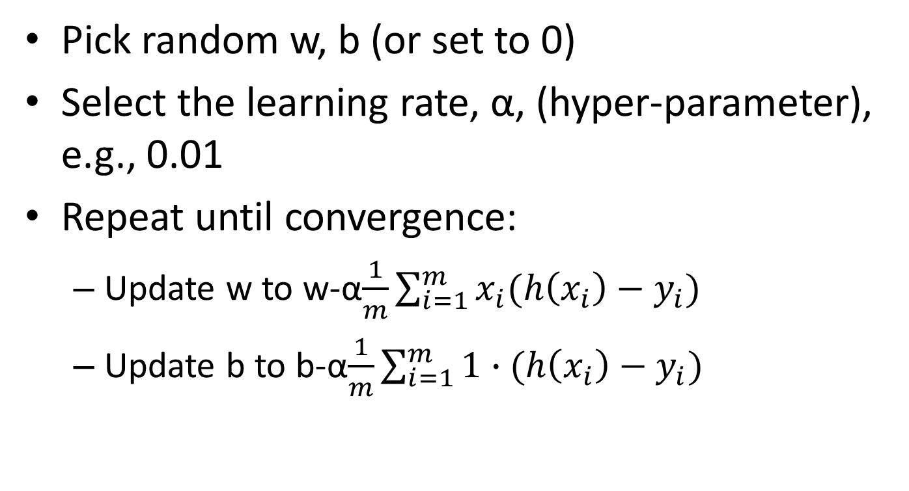
Gradient Descent in Linear Regression
Pick random w, b (or set to 0)
Select the learning rate, α, (hyper-parameter), e.g., 0.01
Repeat until convergence:
Update w to w-α$\frac{1}{m}\sum_{i=1}^{m}{x_{i}(h\left(x_{i}\right)−y_{i})}$
Update b to b-α$\frac{1}{m}\sum_{i=1}^{m}{\text{1}∙(h\left(x_{i}\right)−y_{i})}$
Intuition?
Notes:
Draw dots and a line, and show how the b changes, and then how the w changes.

Slide 11
Linear Regression with BGD in Python (Using the Galaxy Data-set)
import numpy as np
galaxy_data = np.array([[2,70],[3,110],[4,165],[6,390],[7,550]])
w = 0
b = 0
alpha = 0.01
for iteration in range(10000):
gradient_b = np.mean(1*((w*galaxy_data[:,0]+b) - galaxy_data[:,1]))
gradient_w = np.mean(galaxy_data[:,0]*((w*galaxy_data[:,0]+b)-galaxy_data[:,1]))
b -= alpha*gradient_b
w -= alpha*gradient_w
if iteration % 200 == 0 :
print("it:%d, grad_w:%.3f, grad_b:%.3f, w:%.3f, b:%.3f" %(iteration, gradient_w, gradient_b, w, b))
print("Estimated price for Galaxy S5: ", w*5 + b)
Notes:
Note that we are multiplying vectors!

Slide 12
Result:
it:0, grad_w:1464.000, grad_b:257.000, w:14.640, b:2.570
it:200, grad_w:3.825, grad_b:-19.693, w:70.598, b:-33.968
it:400, grad_w:2.859, grad_b:-14.720, w:77.230, b:-68.115
it:600, grad_w:2.137, grad_b:-11.003, w:82.188, b:-93.639
it:800, grad_w:1.597, grad_b:-8.224, w:85.893, b:-112.717
it:1000, grad_w:1.194, grad_b:-6.147, w:88.663, b:-126.977
it:1400, grad_w:0.667, grad_b:-3.434, w:92.280, b:-145.604
it:1800, grad_w:0.373, grad_b:-1.919, w:94.301, b:-156.010
it:2600, grad_w:0.116, grad_b:-0.599, w:96.062, b:-165.073
it:3600, grad_w:0.027, grad_b:-0.140, w:96.674, b:-168.226
it:4400, grad_w:0.008, grad_b:-0.044, w:96.802, b:-168.886
it:5400, grad_w:0.002, grad_b:-0.010, w:96.847, b:-169.116
it:6200, grad_w:0.001, grad_b:-0.003, w:96.856, b:-169.164
it:7000, grad_w:0.000, grad_b:-0.001, w:96.859, b:-169.179
it:7800, grad_w:0.000, grad_b:-0.000, w:96.860, b:-169.184
it:9800, grad_w:0.000, grad_b:-0.000, w:96.860, b:-169.186
Estimated price for Galaxy S5: 315.116281573
What would happen with alpha=0.5?
Actual price was: $250
Estimated price for Galaxy S1 is: -72.22 ☹
Notes:
With alpha=0.5, it would jump from side to side and would not converge.

Slide 13
Adding Features
Screen size
Number of cores
Core speed
Memory size
Time it takes to boot
…
$$h\left(x_{t}\right)=w_{1}x_{t1}+w_{2}x_{t2}+ …+b$$

Slide 14
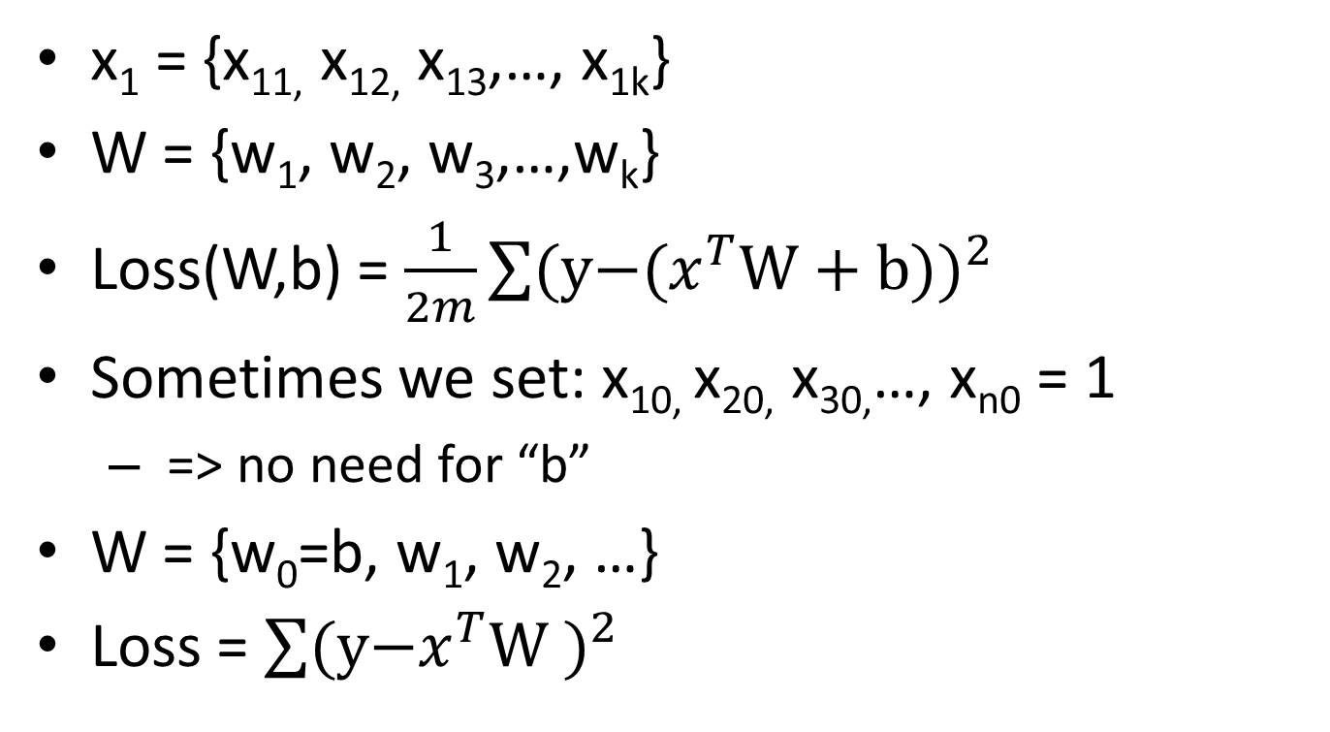
Adding Features (cont.)
x₁ = {x_{11,} x_{12,} x₁₃,…, x_{1k}}
W = {w₁, w₂, w₃,…,w_{k}}
Loss(W,b) = $\frac{1}{2m}\sum{{\text{(}\text{y}\text{−(}x^{T}\text{W}\text{ + }\text{b}\text{))}}^{2}}$
Sometimes we set: x_{10,} x_{20,} x_{30,}…, x_{n0} = 1
=> no need for “b”
W = {w₀=b, w₁, w₂, …}
Loss = $\sum{{\text{(}\text{y}\text{−}x^{T}\text{W}\text{ )}}^{2}}$

Slide 15
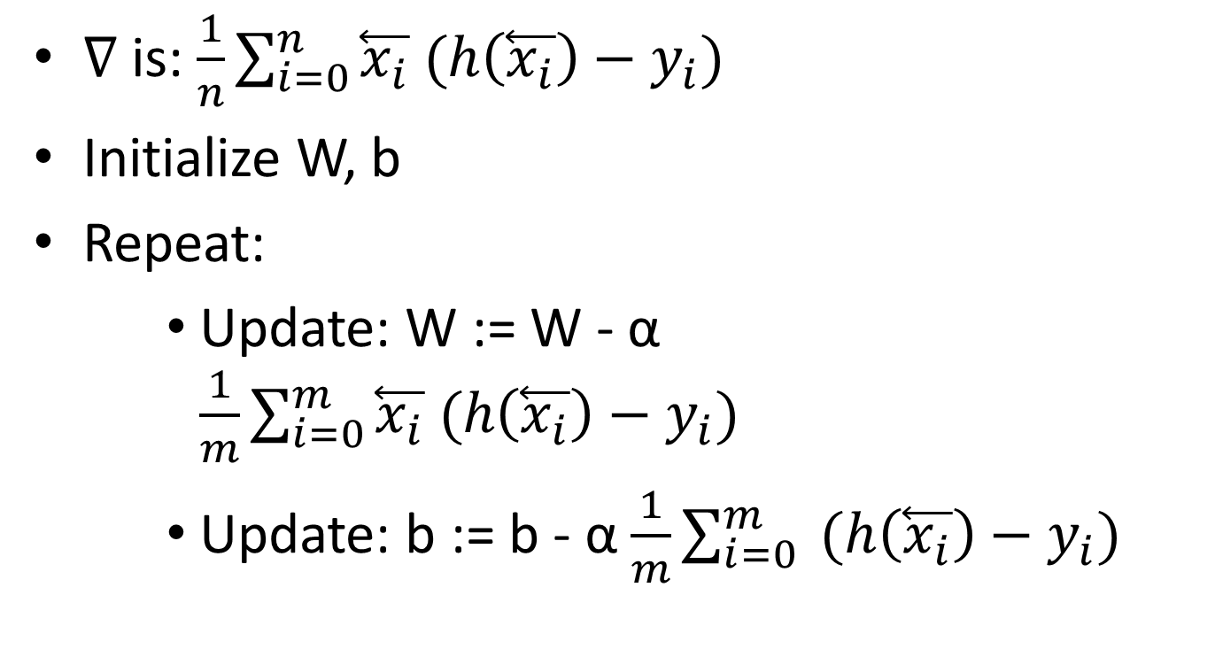
Gradient Descent with Multiple Features (is actually the same…)
∇ is: $\frac{1}{n}\sum_{i=0}^{n}{\overset{⃖}{x_{i}} (h\left(\overset{⃖}{x_{i}}\right)−y_{i})}$
Initialize W, b
Repeat:
Update: W := W - α $\frac{1}{m}\sum_{i=0}^{m}{\overset{⃖}{x_{i}} (h\left(\overset{⃖}{x_{i}}\right)−y_{i})}$
Update: b := b - α $\frac{1}{m}\sum_{i=0}^{m}{ (h\left(\overset{⃖}{x_{i}}\right)−y_{i})}$

Slide 16
Adding a quadratic feature
We can add a feature which is simply a square of the first feature.
We will end up with 2 weights and one bias:
w₁ x + w₂ x² + b
This way, instead of fitting a linear line, we are actually fitting a quadratic function (parabola).

Slide 17
Quadratic Feature
import numpy as np data_x = np.array([[2,4],[3,9],[4,16],[6,36],[7,49]]) data_y = np.array([70,110,165,390,550]) w1 = 0 w2 = 0 b = 0 alpha = 0.001 for iteration in range(1000000): gradient_b = np.mean(1*(data_y-(w1*data_x[:,0]+w2*data_x[:,1]+b))) gradient_w1 = np.dot((data_y-(w1*data_x[:,0]+w2*data_x[:,1]+b)), data_x[:,0]) * 1.0/len(data_y) gradient_w2 = np.dot((data_y-(w1*data_x[:,0]+w2*data_x[:,1]+b)), data_x[:,1]) * 1.0/len(data_y) b += alpha*gradient_b w1 += alpha*gradient_w1 w2 += alpha * gradient_w2 print("Estimated price for Galaxy S5: ", np.dot(np.array([5,25]),np.array([w1, w2])) + b) print("Estimated price for Galaxy S1: ", np.dot(np.array([1,1]),np.array([w1, w2])) + b)
Notes:
import numpy as np
import tensorflow as tf

Slide 18
Quadratic Feature (Weights as Vectors)
data_x = np.array([[2,4],[3,9],[4,16],[6,36],[7,49]]) data_y = np.array([70,110,165,390,550]) w = np.array([0.,0]) b = 0 alpha = 0.001 for iteration in range(1000000): gradient_b = np.mean(1*(data_y-(np.dot(data_x,w)+b))) gradient_w = 1.0/len(data_y) * np.dot((data_y-(np.dot(data_x,w)+b)), data_x) b += alpha*gradient_b w += alpha*gradient_w print("Estimated price for Galaxy S5: ", np.dot(np.array([5,25]),w) + b) print("Estimated price for Galaxy S1: ", np.dot(np.array([1,1]),w) + b)

Slide 19


Results
Prediction for Galaxy S5: $263.63
(actual: $250)
Prediction for Galaxy S1: $71.81
(actual: $30)
Notes:
But still much better than a negative value…

Slide 20
TensorFlow – Quadratic Feature
features = 2
x = tf.placeholder(tf.float32, [None, features])
y_ = tf.placeholder(tf.float32, [None, 1])
W = tf.Variable(tf.zeros([features,1]))
b = tf.Variable(tf.zeros([1]))
pred = tf.matmul(x,W) + b
loss = tf.reduce_mean(tf.pow(pred - y_, 2))
update = tf.train.GradientDescentOptimizer(0.001).minimize(loss)
data_x = np.array([[2,4],[3,9],[4,16],[6,36],[7,49]])
data_y = np.array([[70],[110],[165],[390],[550]])
sess = tf.Session()
sess.run(tf.global_variables_initializer())
for i in range(0,100000):
sess.run(update, feed_dict = {x:data_x, y_:data_y})
if i % 10000 == 0 :
print('Iteration:' , i , ' W:' , sess.run(W) , ' b:' , sess.run(b), ' loss:', loss.eval(session=sess, feed_dict = {x:data_x, y_:data_y}))
Now x is a matrix (m x 2)
Notes:
import numpy as np
import tensorflow as tf

Slide 21
Results
>>> print('Prediction for Galaxy S5:', np.matmul(np.array([5,25]),sess.run(W)) + sess.run(b))
Prediction for Galaxy S5: $264.72 (actual: $250)
>>> print('Prediction for Galaxy S1:', np.matmul(np.array([1,1]),sess.run(W)) + sess.run(b))
Prediction for Galaxy S1: $68.20 (actual: $30)

Slide 22
Adding (too) Many Features
import tensorflow as tf
import numpy as np
features = 20
suff_feat = range(1,features+1);
np.random.shuffle(suff_feat)
def vecto(x):
ret = []
for i in suff_feat:
ret.append(x**i / 7.**i)
return ret
x = tf.placeholder(tf.float32, [None, features])
y_ = tf.placeholder(tf.float32, [None, 1])
W = tf.Variable(tf.zeros([features,1]))
b = tf.Variable(tf.zeros([1]))
y = tf.matmul(x,W) + b
loss = tf.reduce_mean(tf.pow(y - y_, 2))
update = tf.train.GradientDescentOptimizer(0.1).minimize(loss)
data_x = np.array([vecto(2),vecto(3),vecto(4),vecto(6),vecto(7)])
data_y = np.array([[70],[110],[165],[390],[550]])
sess = tf.Session()
sess.run(tf.global_variables_initializer())
for i in range(0,1000000):
sess.run(update, feed_dict = {x:data_x, y_:data_y})
if i % 10000 == 0 :
print('Iteration:' , i , ' W:' , sess.run(W) , ' b:' , sess.run(b), ' loss:', loss.eval(session=sess, feed_dict = {x:data_x, y_:data_y}))
x_axis = np.arange(0, 8, 0.1)
x_data = []
for i in x_axis:
x_data.append(vecto(i))
x_data = np.array(x_data)
y_vals = np.matmul(x_data, sess.run(W)) + sess.run(b)
import matplotlib.pyplot as plt
plt.plot(x_axis, y_vals)
plt.show()
20 features
A function to convert a number to a vector, with all powers.
We divide by 7**I, so the numbers aren't too large.
Plot the results!

Slide 23
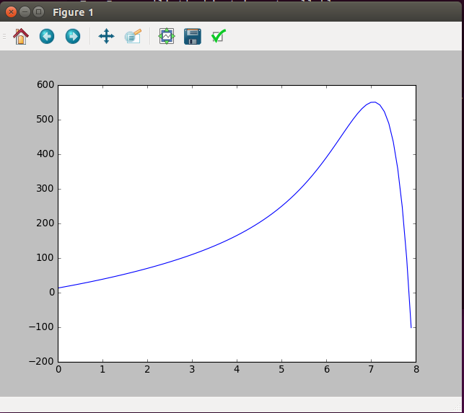
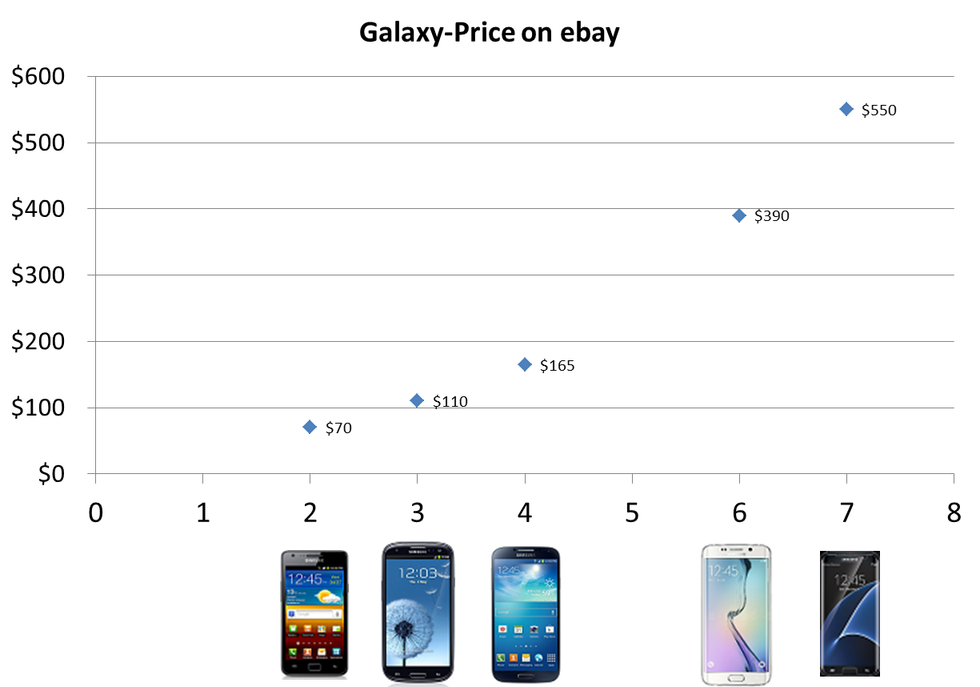
Over-Fitting
Loss = 5.3*10⁻⁷!!!
Bad prediction for 0
Horrible prediction for 8

Slide 24
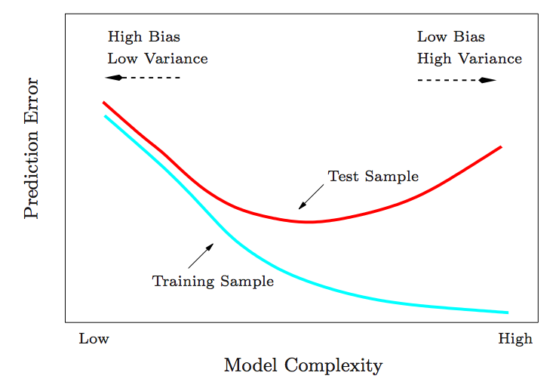
Train/Test error
Credit: Collindcarroll.com

Slide 25
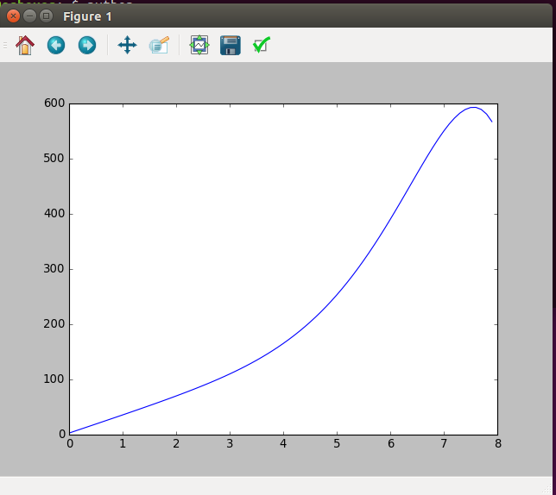
Results with "only" 10 features
Loss = 0.0049

Slide 26
Train-Test-Validation
If we want the test set to be a good prediction to what will happen with new data, it should be used only once.
Therefore, we may want to have a validation set.
The hyper-parameters / model complexity will be determined such that they maximize the accuracy of the validation set.

Slide 27

Regularization
Adding additional terms which penalize the weights.
May reduce variance of complex models.
Examples:
Lasso:
Lasso is more aggressive towards smaller weights, so many end-up zero.
Ridge regression:
Many weights may end-up being small, but not zero.
What is the gradient?
Notes:
Lasso is not really differentiable.
Note that for w < 0, the (sub-gradient) derivative is lambda, and when w<0 the derivative is –lambda (and at 0 it is undefined). [This is what pushes all the weights to 0.]
There are a few solutions:
The original solution is to use coordinate descent, but it is not implemented in tensorflow.
One can use a different optimizer such as Adam which should work.
Another option (which is always a good idea) is to reduce the learning rate (alpha) over time. E.g. alpha:= alpha*0.99, or linearly decrease it.

Slide 28
20 Features but with Regularization (Ridge)
import tensorflow as tf
import numpy as np
features = 20
suff_feat = range(1,features+1);
np.random.shuffle(suff_feat)
def vecto(x):
ret = []
for i in suff_feat:
ret.append(x**i / 7.**i)
return ret
x = tf.placeholder(tf.float32, [None, features])
y_ = tf.placeholder(tf.float32, [None, 1])
W = tf.Variable(tf.zeros([features,1]))
b = tf.Variable(tf.zeros([1]))
pred = tf.matmul(x,W) + b
loss = tf.reduce_mean(tf.pow(pred - y_, 2)) + 0.1*tf.nn.l2_loss(W)
update = tf.train.GradientDescentOptimizer(0.1).minimize(loss)
data_x = np.array([vecto(2),vecto(3),vecto(4),vecto(6),vecto(7)])
data_y = np.array([[70],[110],[165],[390],[550]])
sess = tf.Session()
sess.run(tf.global_variables_initializer())
for i in range(0,100000):
sess.run(update, feed_dict = {x:data_x, y_:data_y})
if i % 10000 == 0 :
print('Iteration:' , i , ' W:' , sess.run(W) , ' b:' , sess.run(b), ' loss:', loss.eval(session=sess, feed_dict = {x:data_x, y_:data_y}))
x_axis = np.arange(0, 8, 0.1)
x_data = []
for i in x_axis:
x_data.append(vecto(i))
x_data = np.array(x_data)
y_vals = np.matmul(x_data, sess.run(W)) + sess.run(b)
import matplotlib.pyplot as plt
plt.plot(x_axis, y_vals)
plt.show()
0.1 is the λ-rate
Ridge
tf.nn.l2_loss(W) = tf.reduce_sum(W**2)/2.

Slide 29
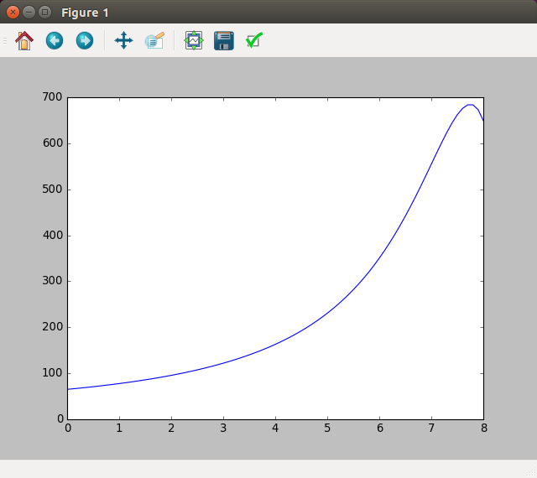
Results (slightly better…)
8 is still not perfect but much better
You can increase/decrease λ and see what happens
0 is much better

Slide 30
Lasso
import tensorflow as tf
import numpy as np
features = 20
suff_feat = range(1,features+1);
np.random.shuffle(suff_feat)
def vecto(x):
ret = []
for i in suff_feat:
ret.append(x**i / 7.**i)
return ret
x = tf.placeholder(tf.float32, [None, features])
y_ = tf.placeholder(tf.float32, [None, 1])
W = tf.Variable(tf.zeros([features,1]))
b = tf.Variable(tf.zeros([1]))
y = tf.matmul(x,W) + b
loss = tf.reduce_mean(tf.pow(y - y_, 2)) + 0.1*tf.reduce_sum(tf.abs(W))
update = tf.train.GradientDescentOptimizer(0.1).minimize(loss)
data_x = np.array([vecto(2),vecto(3),vecto(4),vecto(6),vecto(7)])
data_y = np.array([[70],[110],[165],[390],[550]])
sess = tf.Session()
sess.run(tf.global_variables_initializer())
for i in range(0,100000):
sess.run(update, feed_dict = {x:data_x, y_:data_y})
if i % 10000 == 0 :
print('Iteration:' , i , ' W:' , sess.run(W) , ' b:' , sess.run(b), ' loss:', loss.eval(session=sess, feed_dict = {x:data_x, y_:data_y}))
x_axis = np.arange(0, 8, 0.1)
x_data = []
for i in x_axis:
x_data.append(vecto(i))
x_data = np.array(x_data)
y_vals = np.matmul(x_data, sess.run(W)) + sess.run(b)
import matplotlib.pyplot as plt
plt.plot(x_axis, y_vals)
plt.show()
This doesn't work.
The gradient is not defined at 0. the absolute value function, causes the weights to jump from side to side.
Lasso uses coordinate descent. Unfortunately, I couldn't find any working example of Lasso in TensorFlow, so I used Scikit-learn.

Slide 31
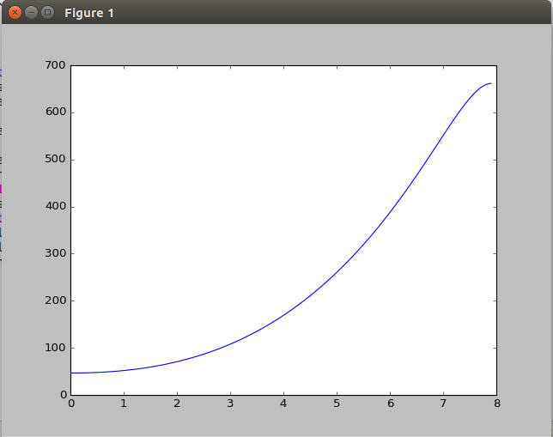
Lasso in Scikit-learn
>>> from sklearn import linear_model
>>> clf = linear_model.Lasso(alpha=0.1)
>>> def vecto(x):
... ret = []
... for i in range(1,21):
... ret.append(x**i/7**i)
... return ret
>>> clf.fit([vecto(2), vecto(3), vecto(4), vecto(6), vecto(7)], [70,110,165,390,550])
Lasso(alpha=0.1, copy_X=True, fit_intercept=True, max_iter=1000,
normalize=False, positive=False, precompute=False, random_state=None,
selection='cyclic', tol=0.0001, warm_start=False)
>>> print(clf.coef_)
[ 0. 221.82464187 236.00210045 54.74659255 0. 0.
0. 0. 0. -0. -0. -0.
-0. -0. -0. -0. -0. -0.
-0. -8.49251129]
>>> print(clf.intercept_)
46.5429646598
>>> import numpy as np
>>> x_axis = np.arange(0,8,0.1)
>>> x_data=[]
>>> for i in x_axis:
... x_data.append(vecto(i))
>>> x_data = np.array(x_data)
>>> clf.predict([vecto(1),vecto(2)])
array([ 51.78085252, 70.52034613])
>>> y_vals = clf.predict(x_data)
>>> import matplotlib.pyplot as plt
>>> plt.plot(x_axis, y_vals)
>>> plt.show()
Results seem even better

Slide 32
Question From 2018 Exam
דקלה הריצה linear regression שלוש פעמים, פעם אחת ללא regularization, פעם Ridge (L2 norm) ופעם Lasso (L1 norm) בדיוק על אותו הדאטה. אך אבוי, היא שכחה מה המשקולות של מה, התוכלו לעזור לה להתאים משקולות למודל? דקלה השתמשה ב10 פיצ'רים, לכן, לכל מודל יש 10 משקולות (+bias). נמקו את תשובותיכם! (10 נק')
[ 0., 219.91359901, 274.65776453, 10.3631787, 0., 0., 0., 0., 0., 0.]
[-202.41650391, 157.2787323, 129.62425232, 174.65600586, 38.83162689, -2.76829815, 23.42464828, 226.38597107, 80.24902344, -77.78523254]
[69.76531982, 27.13533211, 50.87385559, 31.87327003, 66.04504395, 59.18893051, 37.37014008, 43.70231628, 58.64874268, 23.06420135]
Notes:
Lasso
None
Ridge

Slide 33
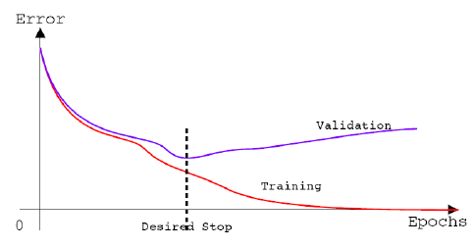
Early Stopping
Credit: https://www.researchgate.net/figure/4310358_fig2_Fig-5-The-early-stopping-criterion

Slide 34
BGD, SGD, MB-GD
Batch Gradient Descent (BGD): uses all Data-set to compute gradient (this is what we learned).
May be too large (to fit in GPU memory), or take too long:
Stochastic Gradient Descent (SGD): uses only a single example at a time (shuffle data first):
More iterations, since each iteration is less accurate
Mini-Batch Gradient Descent (MB-GD): uses only a subset of the data-set, (e.g. 50) at a time (requires shuffle as well):
A compromise which takes advantage of vectorization.
Most widely used in practice (with large datasets).
Sometimes called SGD.

Slide 35



Normalization
$$var=E\left[X^{2}\right]−E{\left[X\right]}^{2}$$
$$var=\frac{1}{σ^{2}}\left(E\left[X^{2}\right]−E{\left[X\right]}^{2}\right)=1$$
It is often beneficial to normalize the data around [0,0,0,…,0] with some standard deviation (1). We subtract the average and divide by standard deviation.
Taking a step in the direction of each feature is more standard (and does not depend on the units used).
Initializing b and w to zero (or near 0) becomes more meaningful.
The resulting weights can compare the importance of each feature (though their meaning becomes vaguer).
Essential when using regularization.
If you also normalize the target (label, y), you will need to multiply the resulted loss by the variance (std²) to obtain your actual loss on the original data.
You can either normalize all data before starting, or use batch-normalization, and normalize data in the given (mini) batch. (We will get back to this.)

Slide 36
Is a Regressor Any Good?
Is a mean squared error (MSE) of 288.5 good?
Compare to the average baseline:
Compute the average of the data, and compute the mean squared error from the average (use average as prediction).
You should really compute average on train, and loss on the test.

Slide 37
Classification

Slide 38
Classification
Suppose we wanted to classify phones into new (1) or old/used (0), using the price as a single feature.
Could we use linear regression?
Notes:
What happens if we add additional points to the right or to the left?
What we actually want is the logistic function!

Slide 39
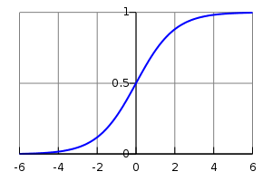
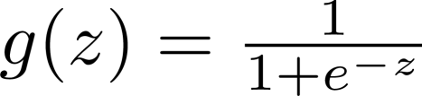
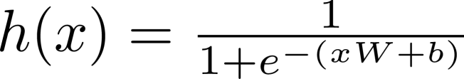
Logistic Regression
The Logistic function is:
Our model function will be:
A prediction of 1 will mean that we are certain that the value is 1.
In general, we want that:
Therefore:
$$p\left(y_{i} | x_{i};w,b\right)=h{\left(x_{i}\right)}^{y_{i}}{\left(1−h\left(x_{i}\right)\right)}^{1−y_{i}}$$
Notes:
The W controls the steepness and the b controls the bias
p(y_i | …) means p(y_i=y | …)

Slide 40
Loss function
Again, we would like to find w,b that will maximize the probability of y's given the x's.

Slide 41
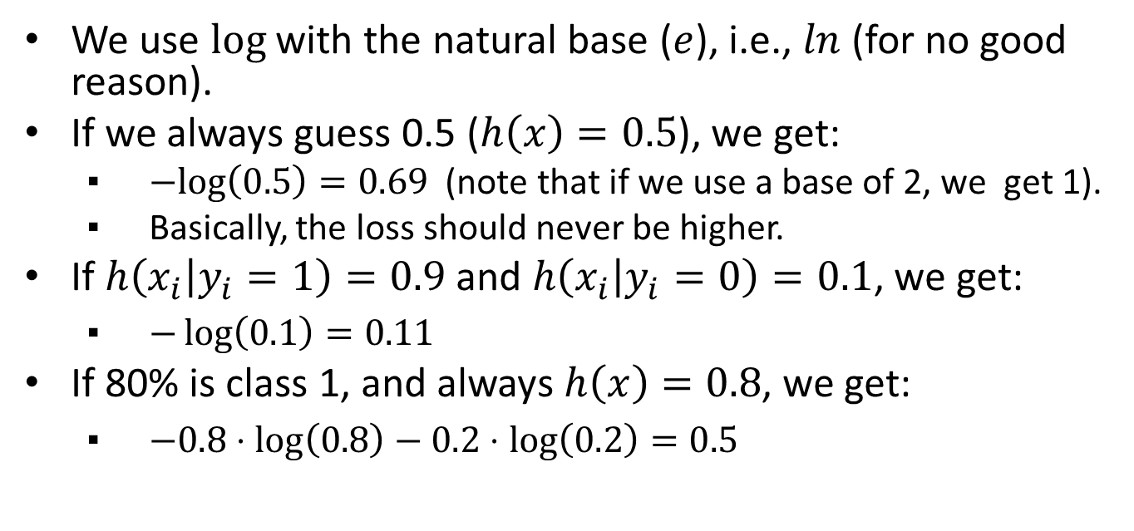
Understanding the Loss Function (Cross Entropy)
We use $log$ with the natural base ($e$), i.e., $ln$ (for no good reason).
If we always guess 0.5 ($h\left(x\right)=0.5$), we get:
$−log\left(0.5\right)=0.69$ (note that if we use a base of 2, we get 1).
Basically, the loss should never be higher.
If $h\left(x_{i} | y_{i}=1\right)=0.9$ and $h\left(x_{i} | y_{i}=0\right)=0.1$, we get:
$−\log\left(0.1\right)=0.11$
If 80% is class 1, and always $h\left(x\right)=0.8$, we get:
$−0.8⋅\log\left(0.8\right)−0.2⋅\log\left(0.2\right)=0.5$

Slide 42
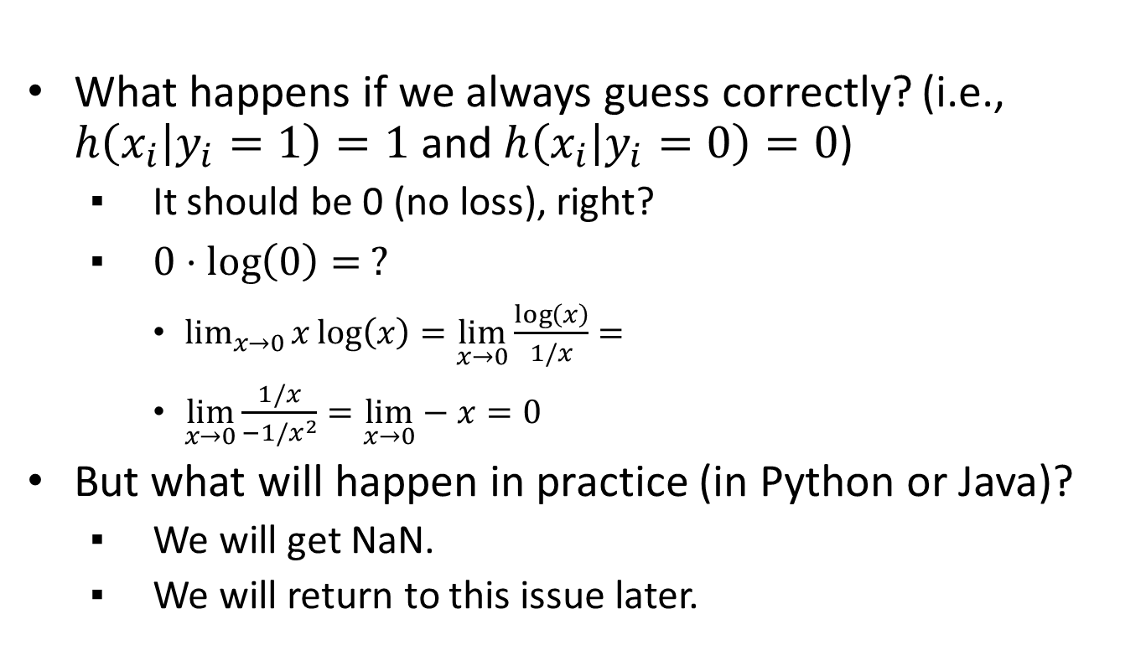
Numerical Issue
What happens if we always guess correctly? (i.e., $h\left(x_{i} | y_{i}=1\right)=1$ and $h\left(x_{i} | y_{i}=0\right)=0$)
It should be 0 (no loss), right?
$0⋅\log\left(0\right)= ?$
$\lim_{x→0}{x\log\left(x\right)}=\lim_{x→0}\frac{\log\left(x\right)}{1/x}=$
$\lim_{x→0}\frac{1/x}{−1/x^{2}}=\lim_{x→0}−x=0$
But what will happen in practice (in Python or Java)?
We will get NaN.
We will return to this issue later.

Slide 43
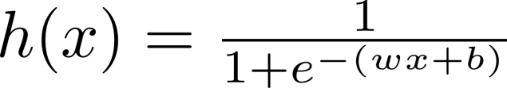
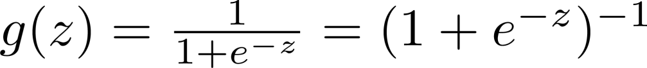
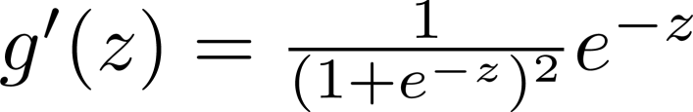
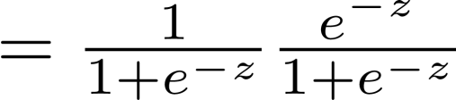
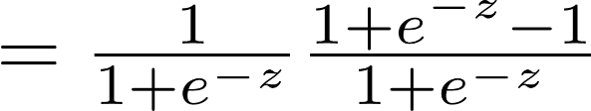
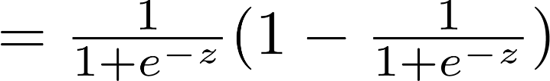

Gradient of Loss
Let's first compute the derivative of the logistic function:

Slide 44


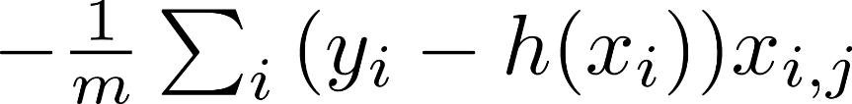
Gradient of Loss (cont.)
Reminder:

Slide 45

Gradient of Loss
Therefore we get the exact same gradient update rule:
$\frac{1}{m}\sum_{i=0}^{n}{x_{i}(h\left(x_{i}\right)−y_{i})}$

Slide 46
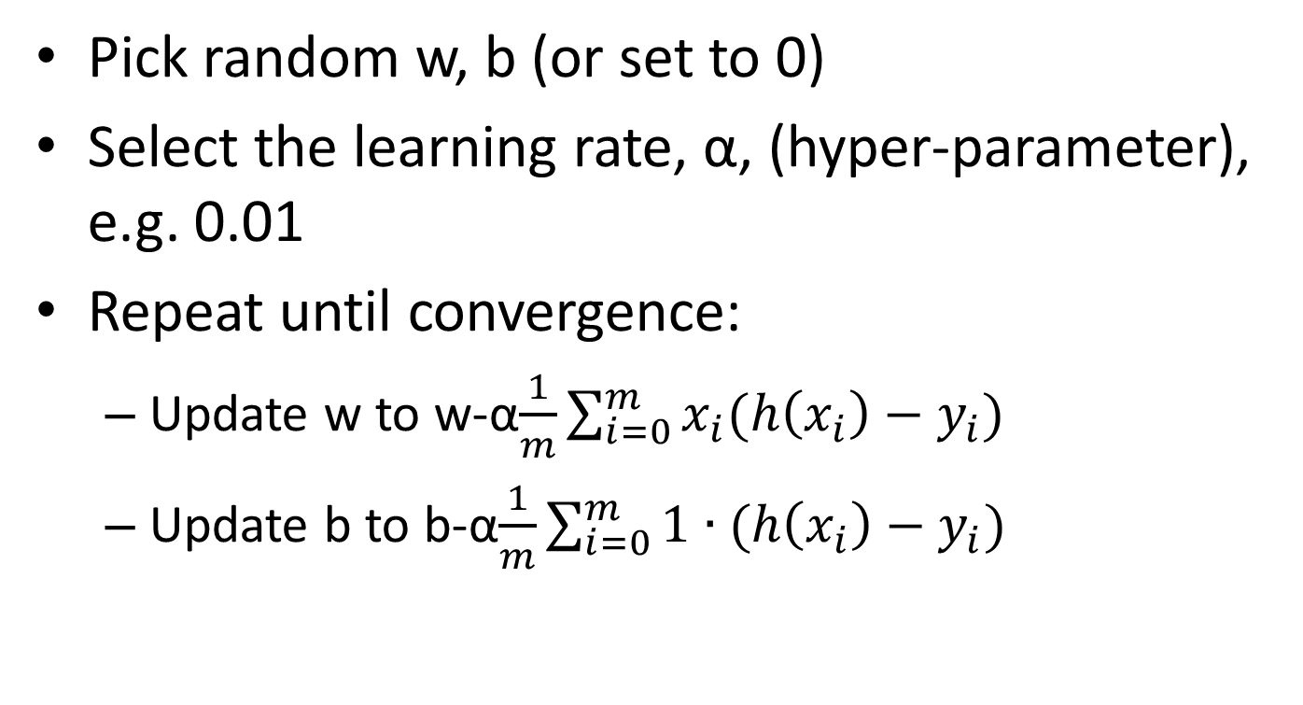
Gradient Descent in Logistic Regression
Pick random w, b (or set to 0)
Select the learning rate, α, (hyper-parameter), e.g. 0.01
Repeat until convergence:
Update w to w-α$\frac{1}{m}\sum_{i=0}^{m}{x_{i}(h\left(x_{i}\right)−y_{i})}$
Update b to b-α$\frac{1}{m}\sum_{i=0}^{m}{\text{1}∙(h\left(x_{i}\right)−y_{i})}$

Slide 47
How-come?
Does the previous slide look familiar?
The previous slide is identical to the slide we have seen in linear regression (I actually did a copy-paste and only changed the title).
So how is logistic regression actually different than linear regression? If it is exactly the same algorithm, why not use linear regression?
Obviously, the algorithms are different because the hypothesis (h(x)) is totally different…

Slide 48
Employed or not?
We have a data-base with all our users and we want to send out job-offers.
For that, we need to know all unemployed users, though we only know this information on a fraction of the data.
We would like to build a classifier that determines whether a user is employed or not, based on the user's age, gender and years of experience.

Slide 49
Our dataset
This is fake data, sorry about any gender/age biases introduced intentionally…
Employed users:
Female, 28 years old, 4 years of experience
Female, 60 years old, 34 years of experience
Female, 25 years old, 3 year of experience
Male, 54 years old, 20 years of experience
Male, 24 years old, 2 years of experience
Male, 39 years old, 12 years of experience
Male, 30 years old, 4 years of experience
Unemployed users:
Female, 36 years old 10 years of experience
Female, 26 years old 1 year of experience
Male, 44 years old, 9 years of experience
Do you think that a female, 49 year old with 8 years of experience employed?
What about a male, 29 years old with 3 years of experience?
And if it were a female?

Slide 50
import numpy as np
data_x = np.array([[1,28,4],[1,60,34],[1,25,3],[0,54,20],[0,24,2],[0,39,12],[0,30,4],[1,36,10],[1,26,1],[0,44,9]])
data_y = np.array([1,1,1,1,1,1,1,0,0,0])
def h(x,w,b):
return 1 / (1+np.exp(-(np.dot(x,w) + b)))
w = np.array([0.,0,0])
b = 0
alpha = 0.001
for iteration in range(100000):
gradient_b = np.mean(1*((h(data_x,w,b))-data_y))
gradient_w = np.dot((h(data_x,w,b)-data_y), data_x)*1/len(data_y)
b -= alpha*gradient_b
w -= alpha*gradient_w
print(w,b)
print("User [1, 49, 8] prob of working: ", h(np.array([[1, 49, 8]]),w,b))
print("User [0, 29, 3] prob of working: ", h(np.array([[0, 29, 3]]),w,b))
print("User [1, 29, 3] prob of working: ", h(np.array([[1, 29, 3]]),w,b))

Slide 51
Results
[-0.93445965 -0.10677388 0.21378302] 3.137632760640033
User [1, 49, 8] prob of working: [ 0.21107079]
User [0, 29, 3] prob of working: [ 0.66430518]
User [1, 29, 3] prob of working: [ 0.43735087]

Slide 52
Classification (Text Example)
Classifying a text message to urgent/non-urgent, based on its words (so the phone will know if to play a notification sound).
E.g.:
“Where are you? I’m trying to reach you for half an hour already, contact me ASAP I need to leave now!”
“I want to go out for lunch, let me know in the next couple of minutes if you would like to join.”
“I was wondering whether you are planning to attend the party we are having next month.”
Any Ideas?
Using logistic regression?

Slide 53
Bag-of-Words Model (like we did while using in Naïve Bayes)
x1 = {0, 0, 0, 0, …., 0, 1, 0, …., 0, 1, 0,…,…,1,…}
aardvark … already … are … … you…
“you” can either get 1 or 2 depending on the selected model.
Instead of using all words, can use only words which appear in the training set or the X most common words while marking the rest as UNK.
Notes:
There can also be a model which records both 1 and 3, or 1, 2, greater than 2, etc.

Slide 54
Logistic Regression in TensorFlow (Preprocessing: Preparing Data)
vocabulary_size = 0 #can use "global" keyword
word2location = {}
def prepare_vocabulary(data):
idx = 0
for sentence in data:
for word in sentence.split(): # better use nltk.word_tokenize(sentence) and perform some stemming etc.!!!
if word not in word2location:
word2location[word] = idx
idx += 1
return idx
def convert2vec(sentence):
res_vec = np.zeros(vocabulary_size)
for word in sentence.split(): #also here...
if word in word2location:
res_vec[word2location[word]] += 1
return res_vec

Slide 55
Logistic Regression in TensorFlow (Preprocessing cont.)
data = ["Where are you? I'm trying to reach you for half an hour already, contact me ASAP I need to leave now!", "I want to go out for lunch, let me know in the next couple of minutes if you would like to join.", "I was wondering whether you are planning to attend the party we are having next month.", "I wanted to share my thoughts with you."]
vocabulary_size = prepare_vocabulary(data)

Slide 56
Logistic Regression in TensorFlow (Preprocessing Examples)
>>> print(convert2vec(data[1])) # "I want to go out for lunch, let me know in the next couple of minutes if you would like to join."
[ 0. 0. 0. 0. 0. 2. 0. 1. 1. 0. 0. 0. 0. 0. 1. 0. 1. 0.
0. 0. 1. 1. 1. 1. 1. 1. 1. 1. 1. 1. 1. 1. 1. 1. 1. 1.
0. 0. 0. 0. 0. 0. 0. 0. 0. 0. 0. 0. 0. 0. 0.]
>>> print(convert2vec(data[0])) # "Where are you? I’m trying to reach you for half an hour already, contact me ASAP I need to leave now!"
[ 1. 1. 1. 1. 1. 2. 1. 1. 1. 1. 1. 1. 1. 1. 1. 1. 1. 1.
1. 1. 0. 0. 0. 0. 0. 0. 0. 0. 0. 0. 0. 0. 0. 0. 0. 0.
0. 0. 0. 0. 0. 0. 0. 0. 0. 0. 0. 0. 0. 0. 0.]

Slide 57
Logistic Regression in TensorFlow (Cont.)
features = vocabulary_size
eps = 1e-12
x = tf.placeholder(tf.float32, [None, features])
y_ = tf.placeholder(tf.float32, [None, 1])
W = tf.Variable(tf.zeros([features,1]))
b = tf.Variable(tf.zeros([1]))
pred = 1 / (1.0 + tf.exp(-(tf.matmul(x,W) + b)))
loss1 = -(y_ * tf.log(pred + eps) + (1 - y_) * tf.log( 1 – pred + eps))
loss = tf.reduce_mean(loss1)
update = tf.train.GradientDescentOptimizer(0.00001).minimize(loss)
data_x = np.array([convert2vec(data[0]), convert2vec(data[1]), convert2vec(data[2]), convert2vec(data[3])])
data_y = np.array([[1],[1],[0],[0]])
sess = tf.Session()
sess.run(tf.global_variables_initializer())
for i in range(0,10000):
sess.run(update, feed_dict = {x:data_x, y_:data_y}) #BGD
Better use:
tf.nn.sigmoid(tf.matmul(x,W) + b)
Instead of two previous rows use:
tf.nn.sigmoid_cross_entropy_with_logits()
Notes:
Obviously, the input data should be given in a nicer way. E.g. [convert2vec(data[i]) for i in range(len(data))]
You can recheck the differences at home.
Use tf.sigmoid(), because it deals better w
Adding an epsilon is shouldn't be related to having W = 0 and b = 0, because that would give us y=0.5, and it shouldn't be a problem. It is especially required for when W and b become very large or very small and then y (due to numerical issues) becomes either 1 or 0 (this can cause problems even when prediction is correct!!!!).
tf.reduce_mean is still required also when using tf.nn.simoid_cross_entropy_with_logits() (as it returns a vector at the length of the mini-batch)

Slide 58
Logistic Regression in TensorFlow Results
def logistic_fun(z):
return 1/(1.0 + np.exp(-z))
test1 = "I need you now! Please answer ASAP!"
test2 = "I wanted to hear your thoughts about my plans."
#pdb.set_trace()
print('Prediction for: "' + test1 + '"', logistic_fun(np.matmul(np.array([convert2vec(test1)]),sess.run(W)) + sess.run(b))[0][0])
print('Prediction for: "' + test2 + '"', logistic_fun(np.matmul(np.array([convert2vec(test2)]),sess.run(W)) + sess.run(b))[0][0])
('Prediction for: "I need you now! Please answer ASAP!"', 0.5003)
('Prediction for: "I wanted to hear your thoughts about my plans."', 0.4991)
Notes:
If we don't use [0][0], we will get [[0.5043]] instead of 0.5043.

Slide 59
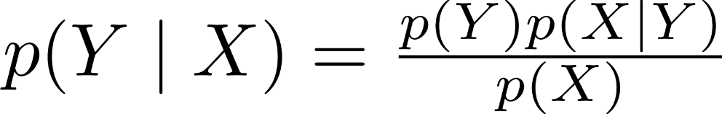
Meaning of Logistic Regression Result
The result given by logistic regression is suppose to relate to the probability of the instance belonging to the class p(y=1 | X).
Logistic regression is a discriminative model, that is, it tries to model p(y | X) directly.
Recall that in the naïve Bayes classifier (which is a generative model), we used the Bayes rule, and therefore had to model:
p(y) and p(X | y) (and p(X))

Slide 60
What is a good classifier?
Accuracy?
What if we classify cancer with a 1% chance?
If we classify all as healthy, we will have 99% accuracy.
What would you think about a classifier that:
catches 98% of the cancers,
but has only 30% precision (if you are told that you might have cancer, there is only 30% that you actually have).
Notes:
You can have additional tests.

Slide 61
Recall and Precision
Confusion Matrix | Classified as Positive | Classified as Negative
Really Positive | True Positive | False Negative
Really Negative | False Positive | True Negative
Accuracy?
Trues / All
(True Positive + True Negative) / (True Positive + True Negative + False Negative + False Positive)
Recall
What fraction of positives did we actually find?
True Positive / Really Positive
True Positive / (True Positive + False Negative)
Precision:
If we say positive, how precise are we?
True Positive / Classified as Positive
True Positive / (True Positive + False Positive)

Slide 62
F-Measure (F₁-Score, F-Score)
A combination of precision and recall (the harmonic mean of the two):
2 (Precision * Recall) / (Precision + Recall)
E.g.:
Precision = 1, recall = 0,
F-Measure = 0
Precision = recall = 0.5
F-Measure = 0.5
Precision = recall = x
F-Measure = x
Harmonic mean is also used in computing velocities on a given distance and resistance of resistors in parallel (must also divide by number of parallel lines)
Notes:
3 ms and 1 ms over a given distance (d), the average speed is 1.5 ms (not 2 ms).
$60Ω$ (ohm) and $20Ω$ in parallel gives $30/2=15Ω$

Slide 63
Imbalanced Data
Solutions:
Under-sampling:
Just ignore data (not good).
Every epoch randomly sample new data from large class.
Over-sampling:
Use the same data many times (only in train).
Loss function interventions:
Weighted loss: multiply loss term of each class (outside of the log) by total_examples/#examples_in_class
The total weight of both classes will eventually be identical.
Use tf.nn.weighted_cross_entropy_with_logits(), and provide total_examples/#examples_in_positive_class
Raise (or reduce) prediction threshold:
At inference (or test), we can set the threshold at 0.4 for instance, (instead of 0.5), this will result in more predictions of the positive class.
Notes:
Or multiply by (total_examples - #examples_in_class)/total_examples (?)

Slide 64
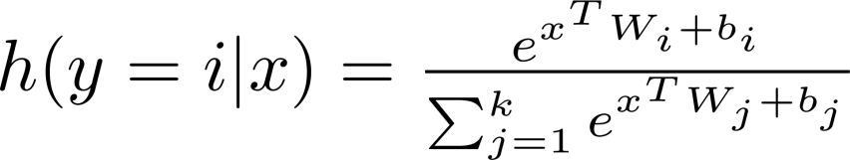
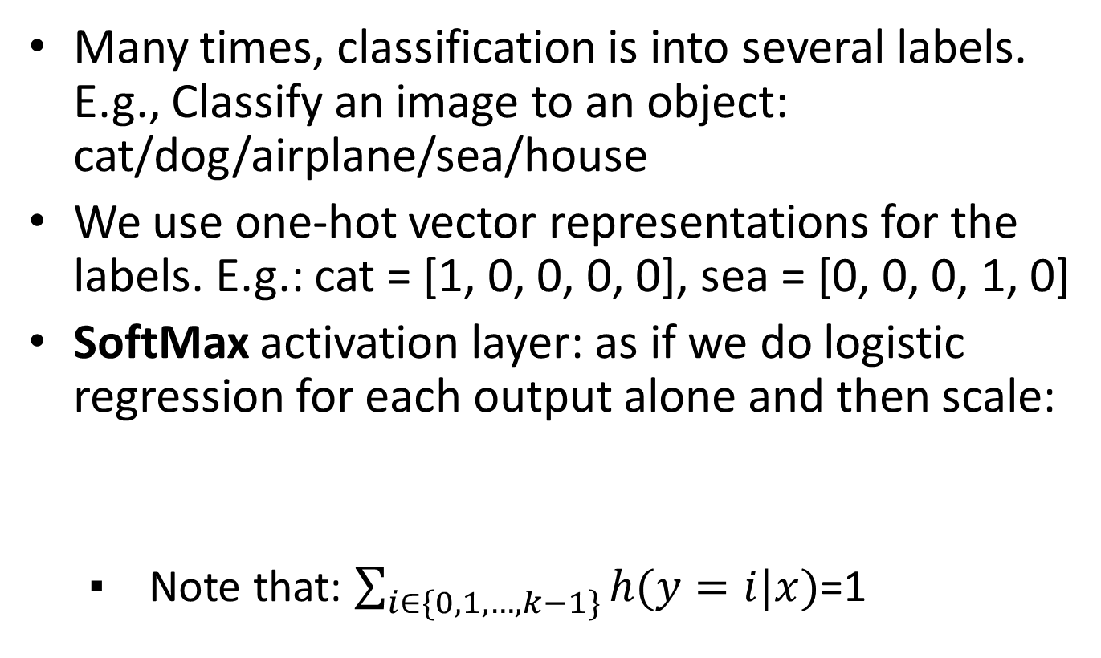
Multiple Classes
Many times, classification is into several labels. E.g., Classify an image to an object: cat/dog/airplane/sea/house
We use one-hot vector representations for the labels. E.g.: cat = [1, 0, 0, 0, 0], sea = [0, 0, 0, 1, 0]
SoftMax activation layer: as if we do logistic regression for each output alone and then scale:
Note that: $\sum_{i∈\{0,1,…,k−1\}}{h(y=i|x)}$=1

Slide 65
SoftMax Example
The values of W_{j}x+b are called the logits.
SoftMax is a soft version of the maximum.
If we get for a given x the following values:
W₁x+b₁ = 1
W₂x+b₂ = 520
W₃x+b₃ = 0.8
W₄x+b₄ = 1.3
What will h(y=2|x) be?
And h(y=1|x)?
Notes:
h(y=2|x) is almost 1.
h(y=1|x) is almost 0.

Slide 66
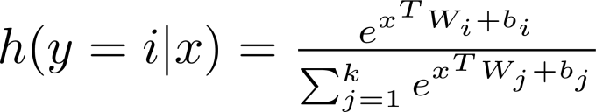
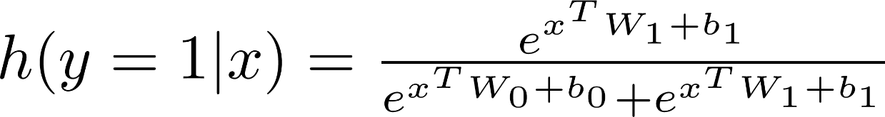
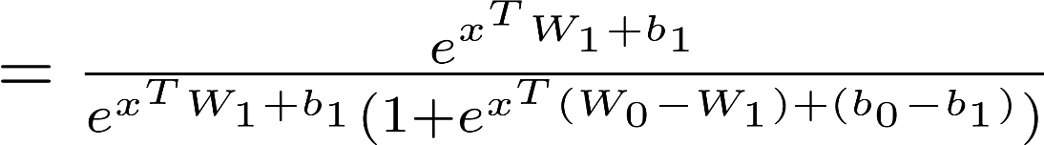
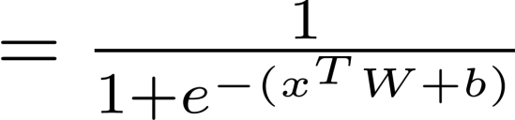
SoftMax and Logistic Regression
SoftMax is a generalization of logistic regression for multiple classes.
For example, if we assume two classes (0 and 1), like we have in logistic regression, we get:
Define W=W₁-W₀ b=b₁-b₀

Slide 67
Average Cross Entropy Loss Function
loss = -tf.reduce_mean(y_*tf.log(pred))
Prediction (SoftMax) | Actual | Log(pred.) | Cross Entropy
[0.4, 0.5, 0.1] | [1, 0, 0] | [-0.92, -0.69, -2.3]
[0.2, 0.7, 0.1] | [0, 1, 0] | [-1.61, -0.36, -2.3]
[0.1, 0.3, 0.6] | [0, 0, 1] | [-2.3, -1.61, -0.51]
-0.92
-0.36
-0.51
y_ and pred are both vectors, since we are evaluating a mini-batch at once.
Loss = 0.597
In practice use: tf.nn.softmax_cross_entropy_with_logits_v2()
(performance and numerical stability)
Note that as with the sigmoid version, this also computes softmax.

Slide 68
Visualization (Logistic Regression)
1st Feature
w₁
2nd Feature
b
sigmoid
w₂
output
0.82
w₃
3rd Feature
w₄
4th Feature
An output of 0.82 means that this classifier believe that there is a 82% chance that this instance is positive.
Therefore, this instance is classified as positive.

Slide 69
Visualization (SoftMax)
w₁₁
b₁
1st Feature
Class1
XW+b
Softmax
0.30
w₂₁
w₁₂
2nd Feature
w₁₃
b₂
w₂₂
Class2
XW+b
0.49
w₁₄
w₂₃
3rd Feature
w₃₁
b₃
w₃₂
Class3
w₂₄
w₃₃
XW+b
0.21
4th Feature
w₃₄
The result is a vector: [0.3, 0.49, 0.21],
which should be interpreted as probabilities
Therefore, this instance was classified as Class2

Slide 70


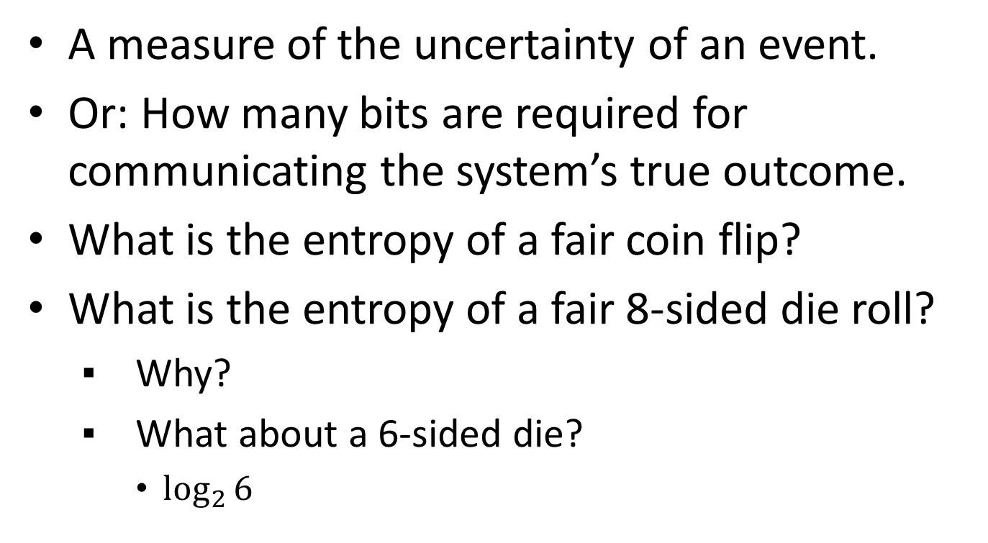
Information Entropy (Shannon)
A measure of the uncertainty of an event.
Or: How many bits are required for communicating the system’s true outcome.
What is the entropy of a fair coin flip?
What is the entropy of a fair 8-sided die roll?
Why?
What about a 6-sided die?
$\log_{2}{6}$
This video might be helpful: https://www.youtube.com/watch?v=ErfnhcEV1O8

Slide 71
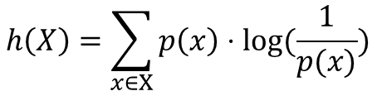
What if the probabilities aren’t equal?
This event seems slightly less uncertain than an equal probability.
Consider the following process/event:
Assumption / axiom: each possible outcome is treated separately. (As if all outcomes had the same probability)
What is the entropy of the “Sunny 🌞” outcome alone?
Why?
The others?
Then we take the expected value. That is, the outcomes are then weighed according to their true probabilities.
1*0.5 + 2*0.25 + 3*0.125 + 3*0.125 = 1.75
Sunny 🌞 | Cloudy ☁ | Rainy 🌧 | Snowy ❄
50% | 25% | 12.5% | 12.5%
Sunny 🌞 | Cloudy ☁ | Rainy 🌧 | Snowy ❄
log(1/0.5)=1 | log(1/0.25)=2 | log(1/0.125)=3 | log(1/0.125)=3
$$h\left(X\right)=\sum_{x∈X}{p\left(x\right)⋅log⁡(\frac{1}{p(x)}) }$$

Slide 72
Cross-Entropy
What happens when a system uses a distribution that is different than the true distribution?
Or: what if a system communicates bits according to a different distribution?
The cross-entropy is the expected number of bits that will be communicated.
That is, the weighted average is now performed using the true distribution.
1*0.32 + 2*0.2 + 3*0.47 + 3*0.01 = 2.16
 | Sunny 🌞 | Cloudy ☁ | Rainy 🌧 | Snowy ❄
System’s belief | 50% 1 bit (0) | 25% 2 bits (10) | 12.5% 3 bits (110) | 12.5% 3 bits (111)
True distribution | 32% | 20% | 47% | 1%

Slide 73


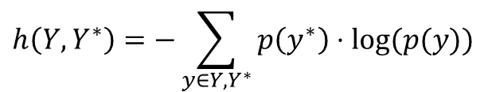
Back to Softmax
The model (system) predicts some distribution for a given example.
The true “distribution” is usually just one of the classes.
So, the cross-entropy is: 2*1.00 = 2.
Two more notes:
We use the natural log (base e).
$\log\left(\frac{1}{p}\right)=\log\left(p^{−1}\right)=−log⁡(p)$
 | Dog | Cat | House | Car
System’s belief | 50% 1 bit (0) | 25% 2 bits (10) | 12.5% 3 bits (110) | 12.5% 3 bits (111)
Label = true “distribution” | 0% | 100% | 0% | 0%
$$h\left(Y,Y^{∗}\right)=−\sum_{y∈Y,Y^{∗}}{p\left(y^{∗}\right)⋅log⁡(p(y)) }$$

Slide 74
SMS Classification
We would like to classify a text message into one of the following:
Finance
Work
Family & Friends
We will be using the same bag-of-words model.

Slide 75
Softmax in TensorFlow
data = [
"Your auto payment of $50 was charges successfully!",
"You have received a refund of $20",
"Please complete your power point presentation by tomorrow.",
"You must arrive on time tomorrow, otherwise the manager will want to talk to you",
"How about celebrating Bob's birthday party next week?",
"Everyone is waiting for you at home, please come home early!"]

Slide 76
Softmax in TensorFlow (cont.)
…
categories = 3
x = tf.placeholder(tf.float32, [None, features])
y_ = tf.placeholder(tf.float32, [None, categories])
W = tf.Variable(tf.zeros([features,categories]))
b = tf.Variable(tf.zeros([categories]))
pred = tf.nn.softmax(tf.matmul(x, W) + b)
loss = -tf.reduce_mean(y_*tf.log(pred))
update = tf.train.GradientDescentOptimizer(0.001).minimize(loss)
data_x = np.array([convert2vec(data[i]) for i in range(len(data))])
data_y = np.array([[1,0,0],[1,0,0],[0,1,0],[0,1,0],[0,0,1],[0,0,1]])
…
Both x and y_ are now matrixes
W is now a matrix
Note the use of SoftMax
And b is a vector
Average cross entropy loss
One-hot vector encoding
Here we do all the training etc. just as before

Slide 77
Results
print('Prediction for: "' + test[i] + ': "', sess.run(y, feed_dict={x:[convert2vec(test[i])]}))
Prediction for: "Your payment has been received, no refund is currently available.: " [[0.51111 0.20785195 0.2810381 ]]
Prediction for: "The manager said that your presentation went well, but next time make sure to arrive on time.: " [[0.12958457 0.7006373 0.16977824]]
Prediction for: "We are all waiting for you at the birthday party: " [[0.14428245 0.19597223 0.6597453 ]]

Slide 78
Numerical Issues
When computing softmax, we compute:
And when computing cross entropy, we compute:
-tf.reduce_mean(y_*tf.log(y))
If h(y|x) becomes 0 (or 1) for any entry, this would cause trouble (even when prediction is correct).
If xW+b is large, e^{xW+b} may become infinty.
Therefore, in practice, we should use: tf.nn.softmax_cross _entropy_with_logits_v2()
When using exclusive labels sparse_softmax_cross_entropy_with_logits() computes entries in which y_ > 0 only.
The Softmax function (or sigmoid) is still required for inference.

Slide 79
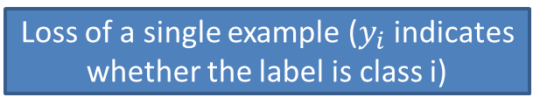
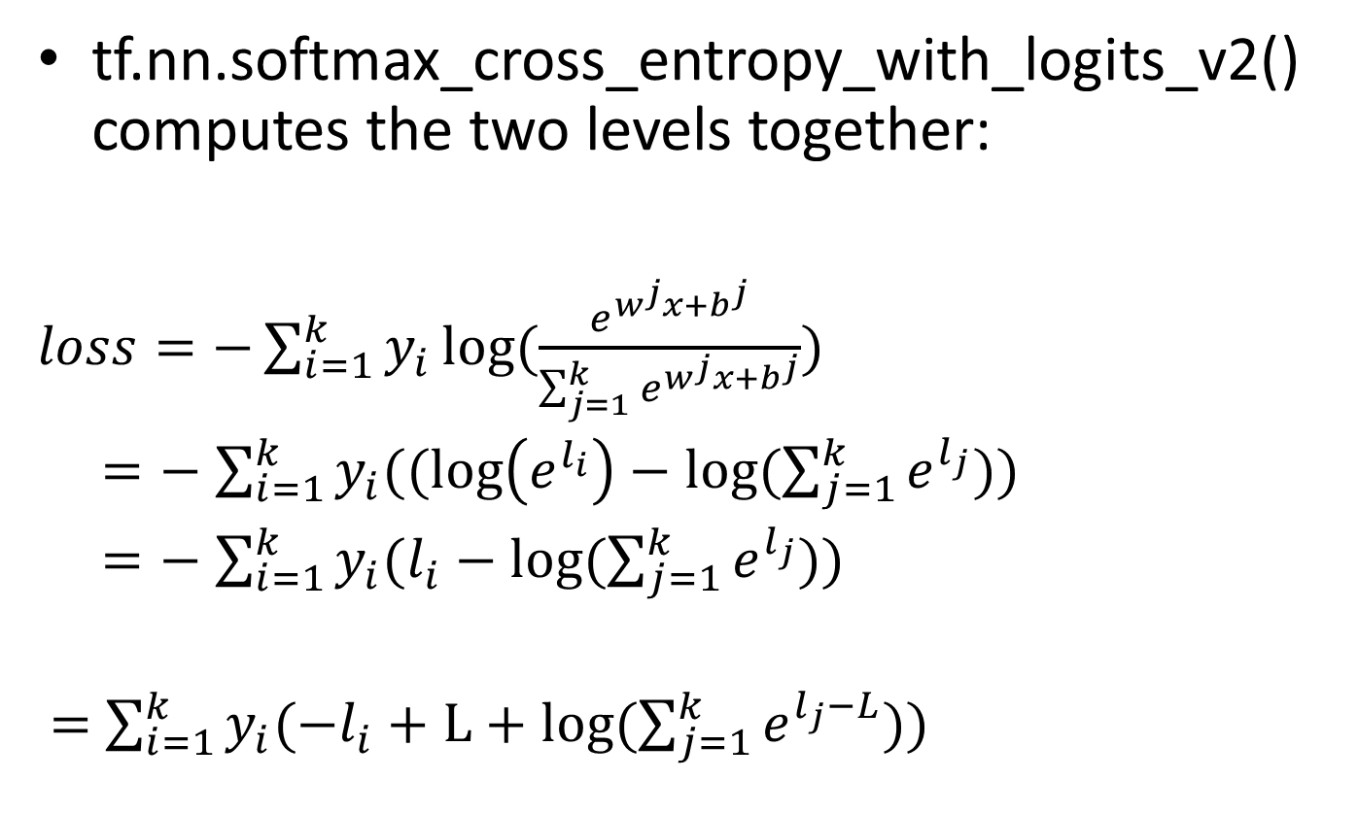
Numerical Issues (cont.)
tf.nn.softmax_cross_entropy_with_logits_v2() computes the two levels together:
$loss=−\sum_{i=1}^{k}{y_{i}}log⁡(\frac{e^{w^{j}x+b^{j}}}{\sum_{j=1}^{k}{e^{w^{j}x+b^{j}}}})$
$=−$ $\sum_{i=1}^{k}{y_{i}((\log\left(e^{l_{i}}\right)−log⁡(\sum_{j=1}^{k}{e^{l_{j}}))}}$
$=−$ $\sum_{i=1}^{k}{y_{i}(l_{i}−log⁡(\sum_{j=1}^{k}{e^{l_{j}}))}}$
$=$ $\sum_{i=1}^{k}{y_{i}(−l_{i}+L+log⁡(\sum_{j=1}^{k}{e^{l_{j}−L}))}}$
Loss of a single example ($y_{i}$ indicates whether the label is class i)
Numerically stable
(computed once, per example)
Notes:
Correct y_i 1/m

Slide 80
Updated code
x = tf.placeholder(tf.float32, [None, features]) y_ = tf.placeholder(tf.float32, [None, categories]) W = tf.Variable(tf.zeros([features,categories])) b = tf.Variable(tf.zeros([categories])) z = tf.matmul(x, W) + b pred = tf.nn.softmax(z) #leave this so it can be used to make predictions. #loss = -tf.reduce_mean(y_*tf.log(pred)) loss = tf.reduce_mean(tf.nn.softmax_cross_entropy_with_logits_v2(y_, z)) update = tf.train.GradientDescentOptimizer(0.001).minimize(loss)

